Slide 1
Reception September 2024

Slide 2
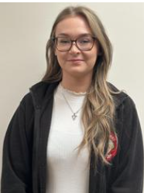
Who’s who in Reception?
Miss Kirk
ECT Teacher
DT Subject Leader
Miss Hughes and Miss Rose are our two Teaching Assistants.

Slide 3
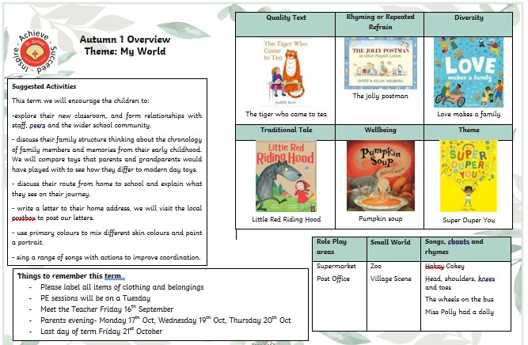


.
& Wednesday
Wednesday 16th October
18th October

Slide 4
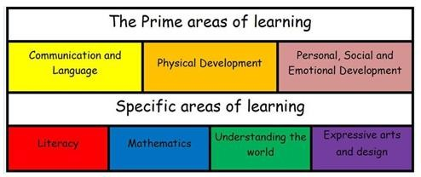
How will the children be assessed?
In Early Years, there are seven areas of learning,
Physical Development
Personal, Social and Emotional Development (PSED)
Communication and Language
Literacy
Mathematics
Understanding the world
Expressive Arts & Design
The three prime areas (in red) underpin the all learning throughout the early years curriculum. We will assess children in Reception using Development Matters which looks at skills that
develop in children from Birth to 3, Age 3-4 and Reception age. We will be working towards Early Learning Goals (ELGs) at the end of the Reception year which will ensure a smooth transition into Year 1 and beyond.
Assessment will be continuous throughout the year, but we will have summative assessments at
the end of each term. This will be fed back to you at parents’ evenings and in reports.

Slide 5

Class Dojo is the main way that we will communicate with you about everyday goings on in the class. We will also use this as a way to notify you about upcoming events and any changes in information.
The main office will update dates and general school information through the ‘My Schools’ app.

Slide 6

When are reading books changed?
Reading books are changed on a Monday and Thursday.
Books will be phonetically decodable, as your child starts to learn phonics, you will be given materials and information to support you at home.

Slide 7
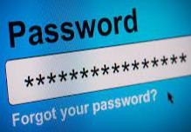
Pick up/Drop off/ Passwords
Parents will be able to pick up and drop off children at the main classroom door.
Drop off each morning will be 8:40am. Children will need to be in class ready to be registered at 8:50am.
Collection time will be 3:20pm
If an alternative adult will be collecting your child, you will need to complete the password sheet for security purposes.

Slide 8
What should I do if my child needs to miss school for any reason?
We politely request that you do not schedule holidays during the school term, however, we understand that absence of leave may sometimes be needed. If your child will need to miss school for any reason, please complete an ‘Absence of Leave form’, which is available at the main office.
If your child is unwell, you need to contact the main office on, each day of absence, to advise us that they will not be attending that day.
If your child needs to attend a medical appointment, you will need to show the main office proof of your appointment.

Slide 9
Lunches
Children can bring their own packed lunches to school.
If you would like your child to have a school dinner, a menu will be sent home in the first term so that you can select lunch options with your child. After Christmas, children will then choose their own school dinner each day during registration time.
The options will always include two hot dinners and a choice of sandwiches.

Slide 10
Our week at a glance…
- Tuesday & Wednesday – PE day- children need to come to school in their PE kits.
We will let you know when they need to start wearing outdoor
kits.
- Thursday- we will be mixing with the Year 6 children
Buddy time-
and the children will each be assigned a buddy. We will have time to play together in our outdoor area. We find this builds secure bonds and relationships with the older children within the school.
Show and Tell
will take place each day, we will issue a timetable so
you know which day your child needs to bring something in to show.

Slide 11
Ways to help us…
Promoting independence with regards to self care- using the toilet/ washing hands.
Dressing themselves- putting on their own coat, doing zips, putting on their school shoes and wellies and changing back.
For those children who will be on school dinners- children to practice using a knife and fork.

