Slide 1
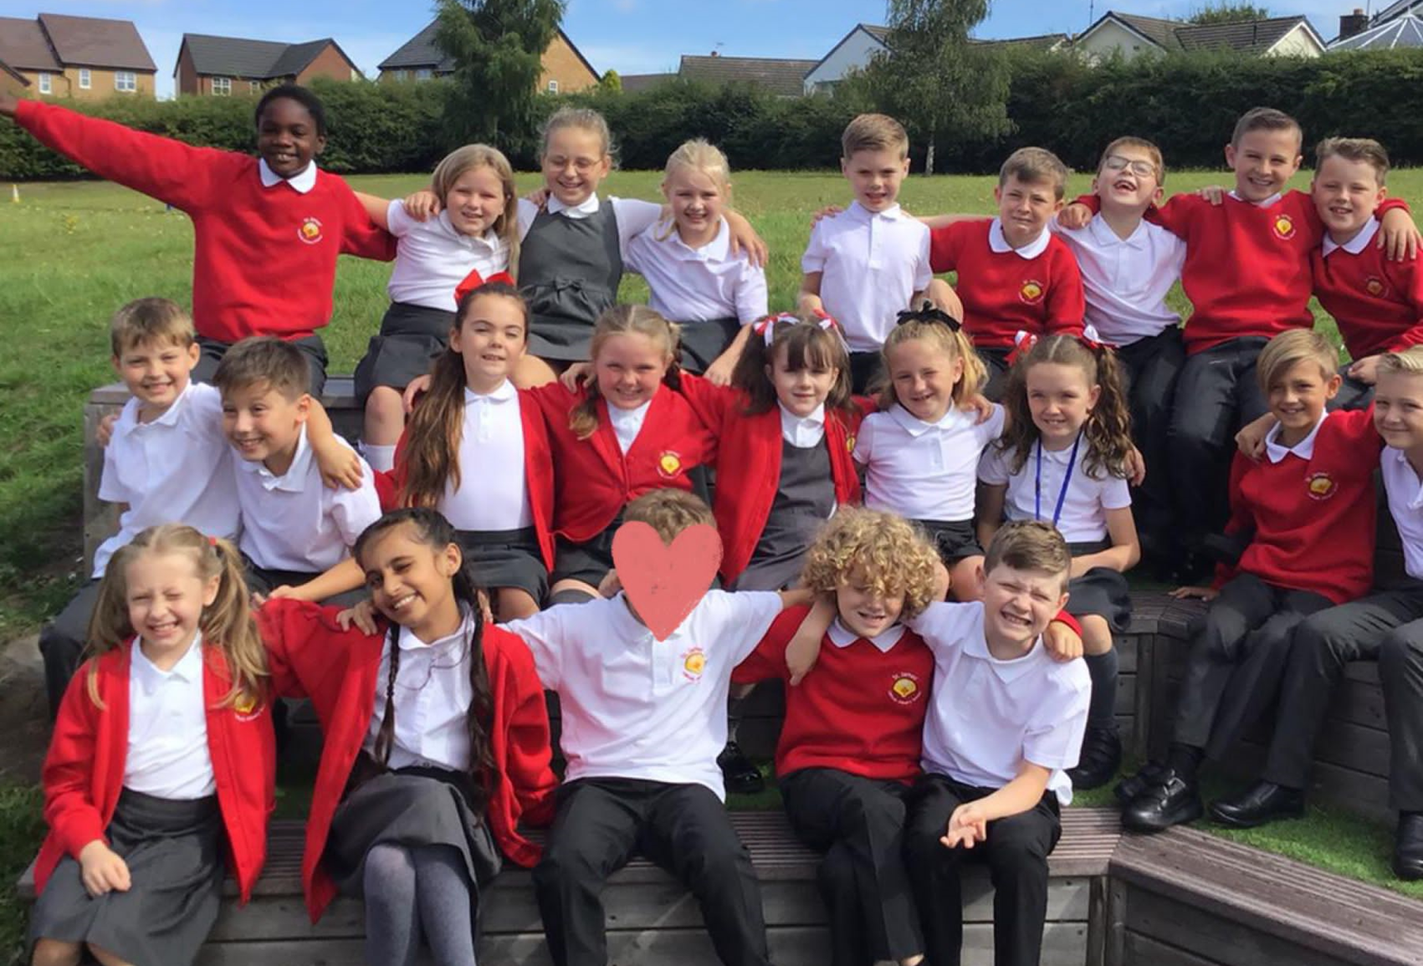

St James’ Catholic Primary
School
2022-23 -Year 4 Overview
Teacher: Mrs Bell
HLTA: Mrs Allan
TA: Mrs Daly

Slide 2
Our Bespoke Curriculum
Core subject | Topic areas
RE | ‘Come and See’ scheme along with daily collective worship – often led by the children.
English | Norse tales, debate, information texts, fantasy stories, newspaper reports, film, stories with a theme, poetry, persuasion, historical fiction, explanation texts, fairy tales and reports.
Maths | Number, measures, calculations, fractions, decimals, money, statistics, geometry, area, problem solving and reasoning
Science | Animals including humans, electricity, states of matter sound and living things
  http://www.st-james-pri.lancs.sch.uk/

Slide 3
The Wider Curriculum
Foundation subject | Topic areas
Art | Rainforest collage, pointillism and photography
DT | Roman sandals and phone cases
Music | Taught by trained musician and music teacher Mrs Edgar
PE | Athletics, dance, games, gymnastic, OAA, swimming
History | The Plague, The Romans in Britain and The Vikings
Geography | South America, The Water Cycle, Mountains
MFL | Presenting myself, family and Christmas, My Home, Romans, Classroom, Goldilocks
PSHE | Health and Well-being, Living in the Wider world and Relationships (alongside Journey in Love)
Computing | E-safety, Collaborative learning, Scratch, Computation Thinking, Investigating Weather, Website Hacking and Fake News

Slide 4
Knowledge based curriculum
Sticky learning is Key – metacognition techniques used daily.
Nurtures any special interests or talents.
By the end of Year 6 children should leave with a good understanding of the World in which they live.
Gives children an excellent understanding of the community they belong to.
Leave with high aspirations – allows children to be the best that they can be, always.

Slide 5

Reading
Guided Reading takes place four times per week.
Range of texts including: fiction, poetry, information and news.
Class novel daily.
Comprehension activities – reading lesson weekly.
First News – childrens’ newspaper.
Opportunities to read for enjoyment regularly – book corner/library – genre challenge
Children will read in school one-to-one and will change books as and when needed.

Slide 6
Targets & Assessment
End of topic assessment for example Place Value
NFER – Termly
Wider curriculum assessments alongside the subject leader
Tracking of individual group
Targets and interventions set termly depending on the child’s needs.
Year 4 Multiplication Tables Check (MTC) – End of June 2023
The purpose of the MTC is to determine whether pupils can recall their times tables fluently, which is essential for future success in mathematics. It will help schools to identify pupils who have not yet mastered their times tables, so that additional support can be provided.
Schools will have a 3-week check window in June to administer the MTC. Teachers will have the flexibility to administer the check to individual pupils, small groups or a whole class at the same time.

Slide 7
Daily Routines
Morning activities from 8.45am – please be prompt
PE – Wednesday and Friday
Assemblies – Monday and Friday
Guided reading 4 times per week
SPAG – daily
Mental arithmetic – Daily
Reading books – can change any day
Timestables test every Friday
Spelling test – given out Friday for following Friday
Snack – healthy
Water bottle daily with water or weak juice.

Slide 8
Behaviour Policy
Our behaviour policy is available on the school website.
The following rules underpin the whole policy:
The three ‘Bs’ –
Be Ready
Be Respectful
Be Safe
Poor behaviour is dealt with through a scaled system 1-5.
Positive behaviour is rewarded through: Regular praise, Dojo points, assembly awards and house points.

Slide 9
PSHE Education
Personal, Social, Health and Emotional Education is now a statutory part of the curriculum.
Taught at the beginning of every week by the class teacher.
If children have: a good understanding of their feelings; a deep rooted mutual respect for others; and a high sense of self-esteem this will impact greatly on their academic achievements.
Worked closely with ‘Flying School’ – using techniques such as rounds and thinking pairs regularly.

Slide 10
Residential 2023
Year 4 will complete a one night, 2 day residential at Hothersall Lodge – usually in the Spring Term.
Hothersall Lodge - Lancashire County Council

Slide 11
Need to speak to me?
Open door policy – feel free to see me at the end of the school day or make an appointment in the office if necessary.
Check out our website regularly to see the curriculum in action.
Class Dojo, parent mail and School app.
Looking forward to a year of working hard, making memories and having lots of fun along the way!

