Slide 1
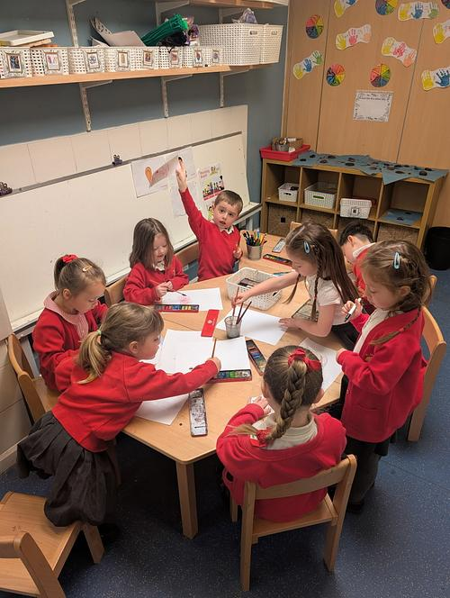
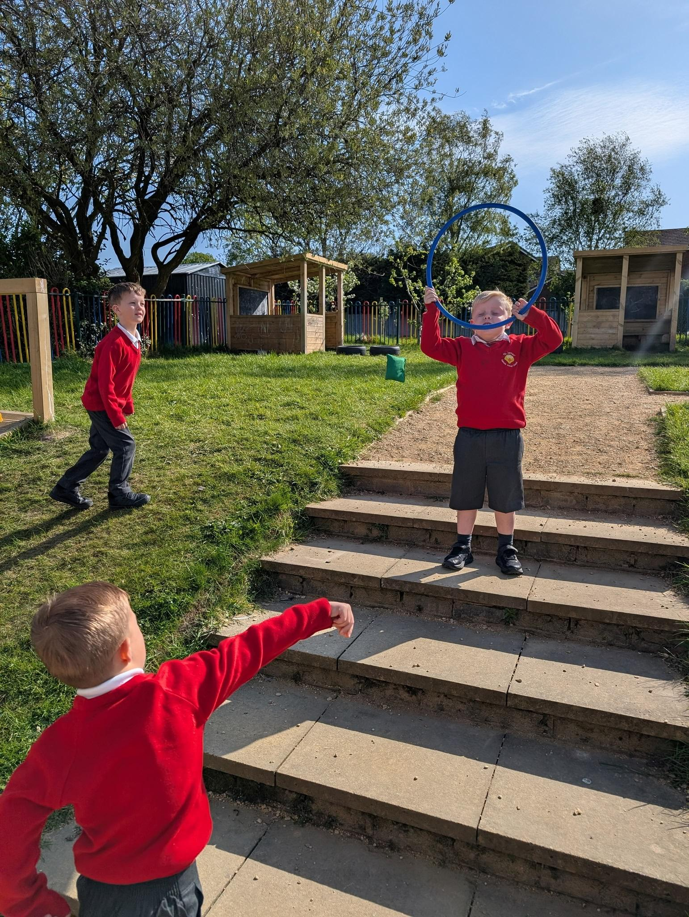
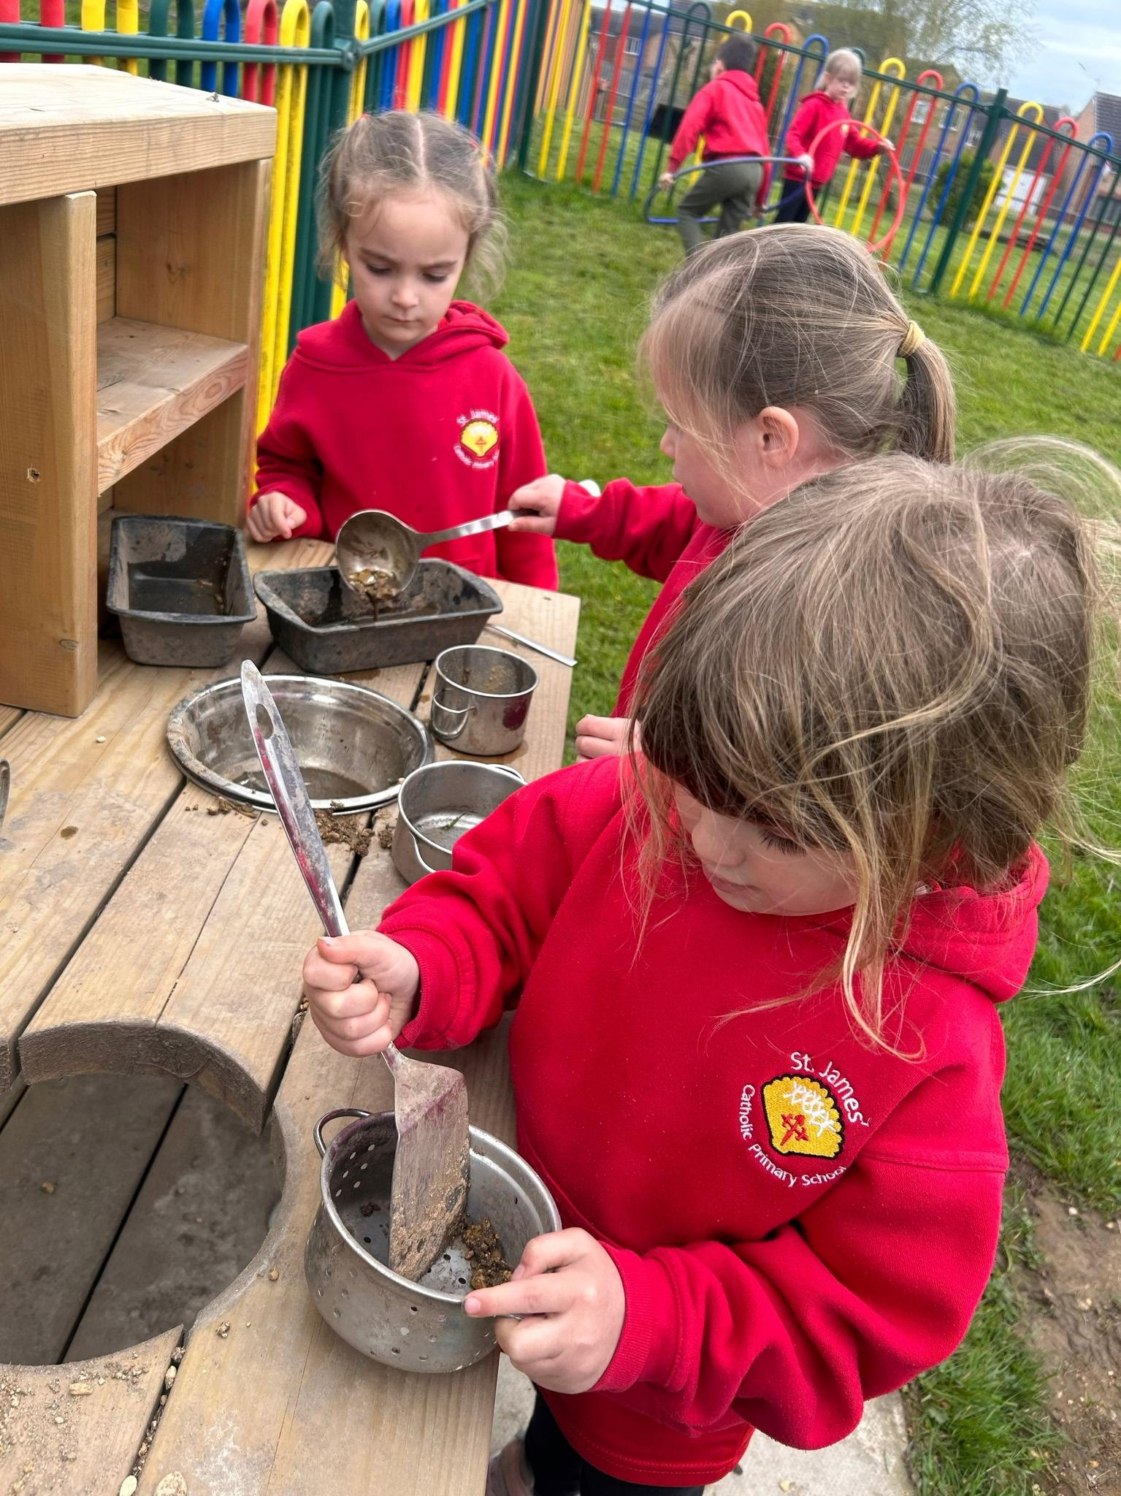
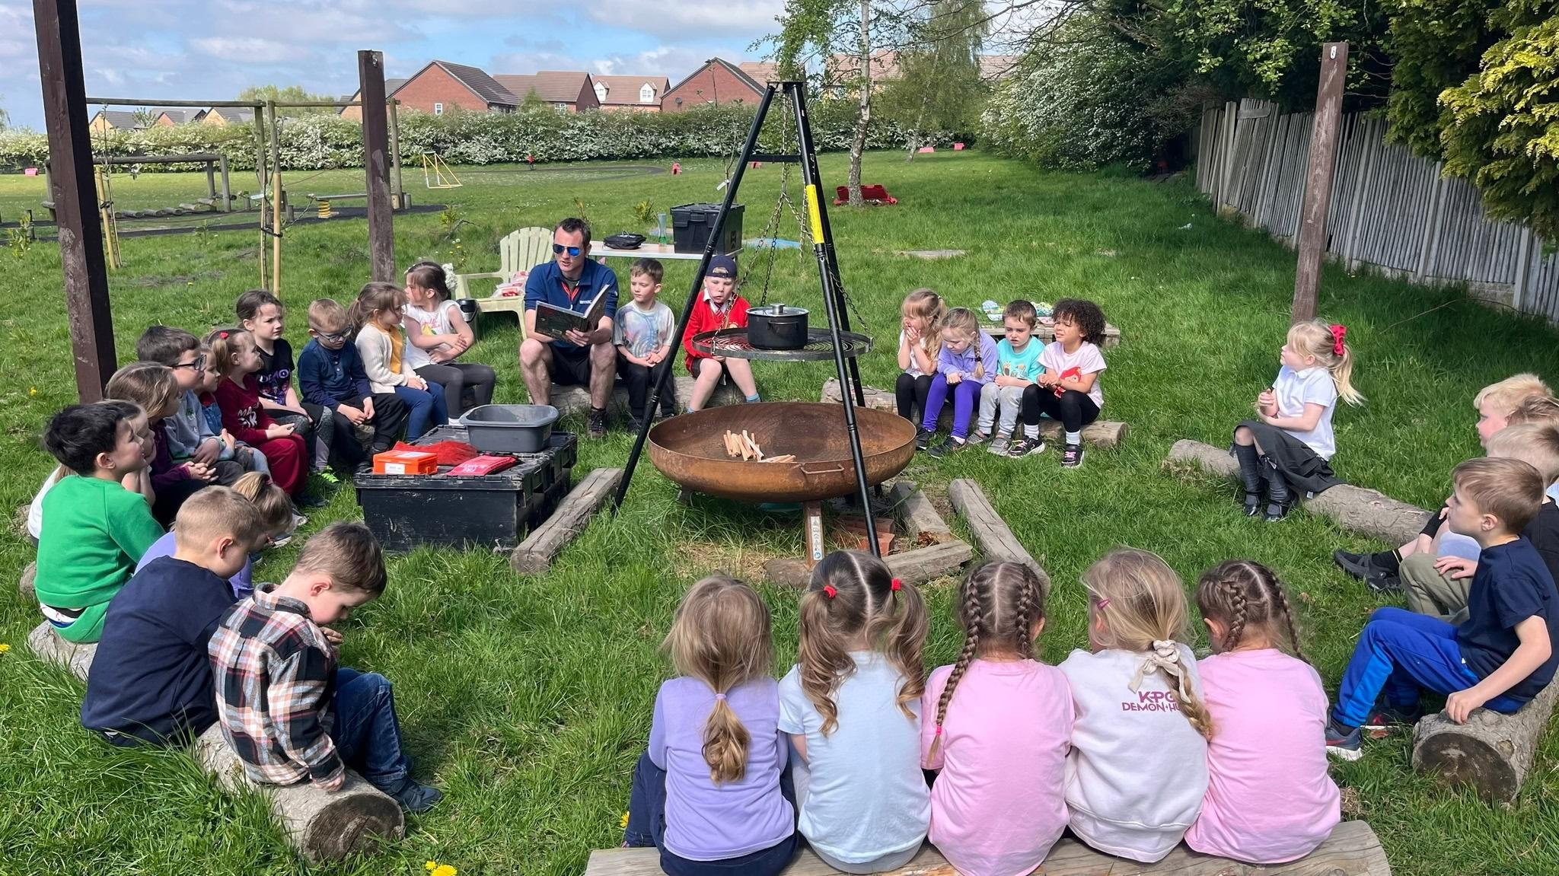
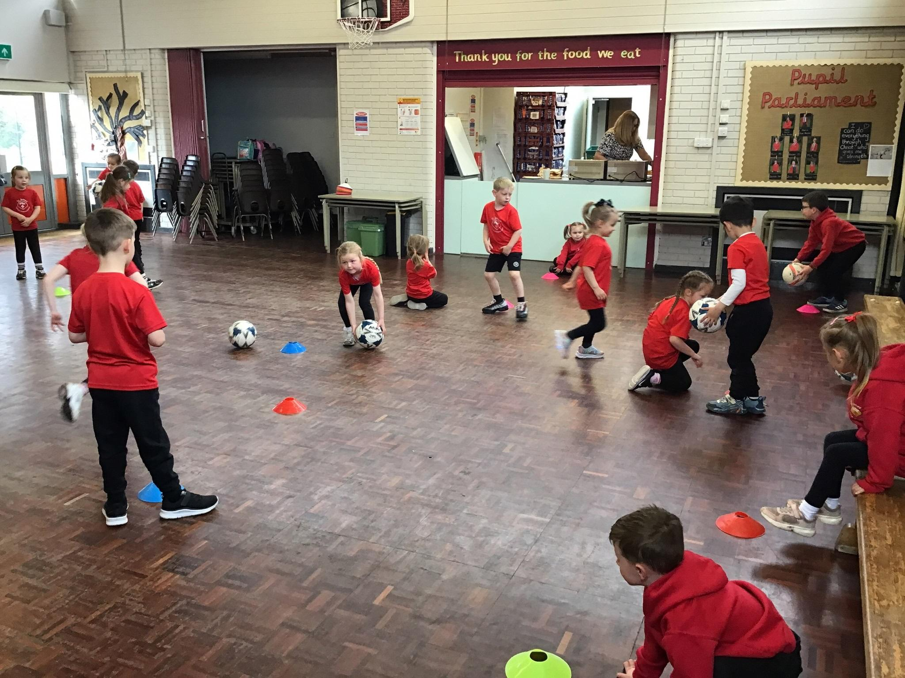
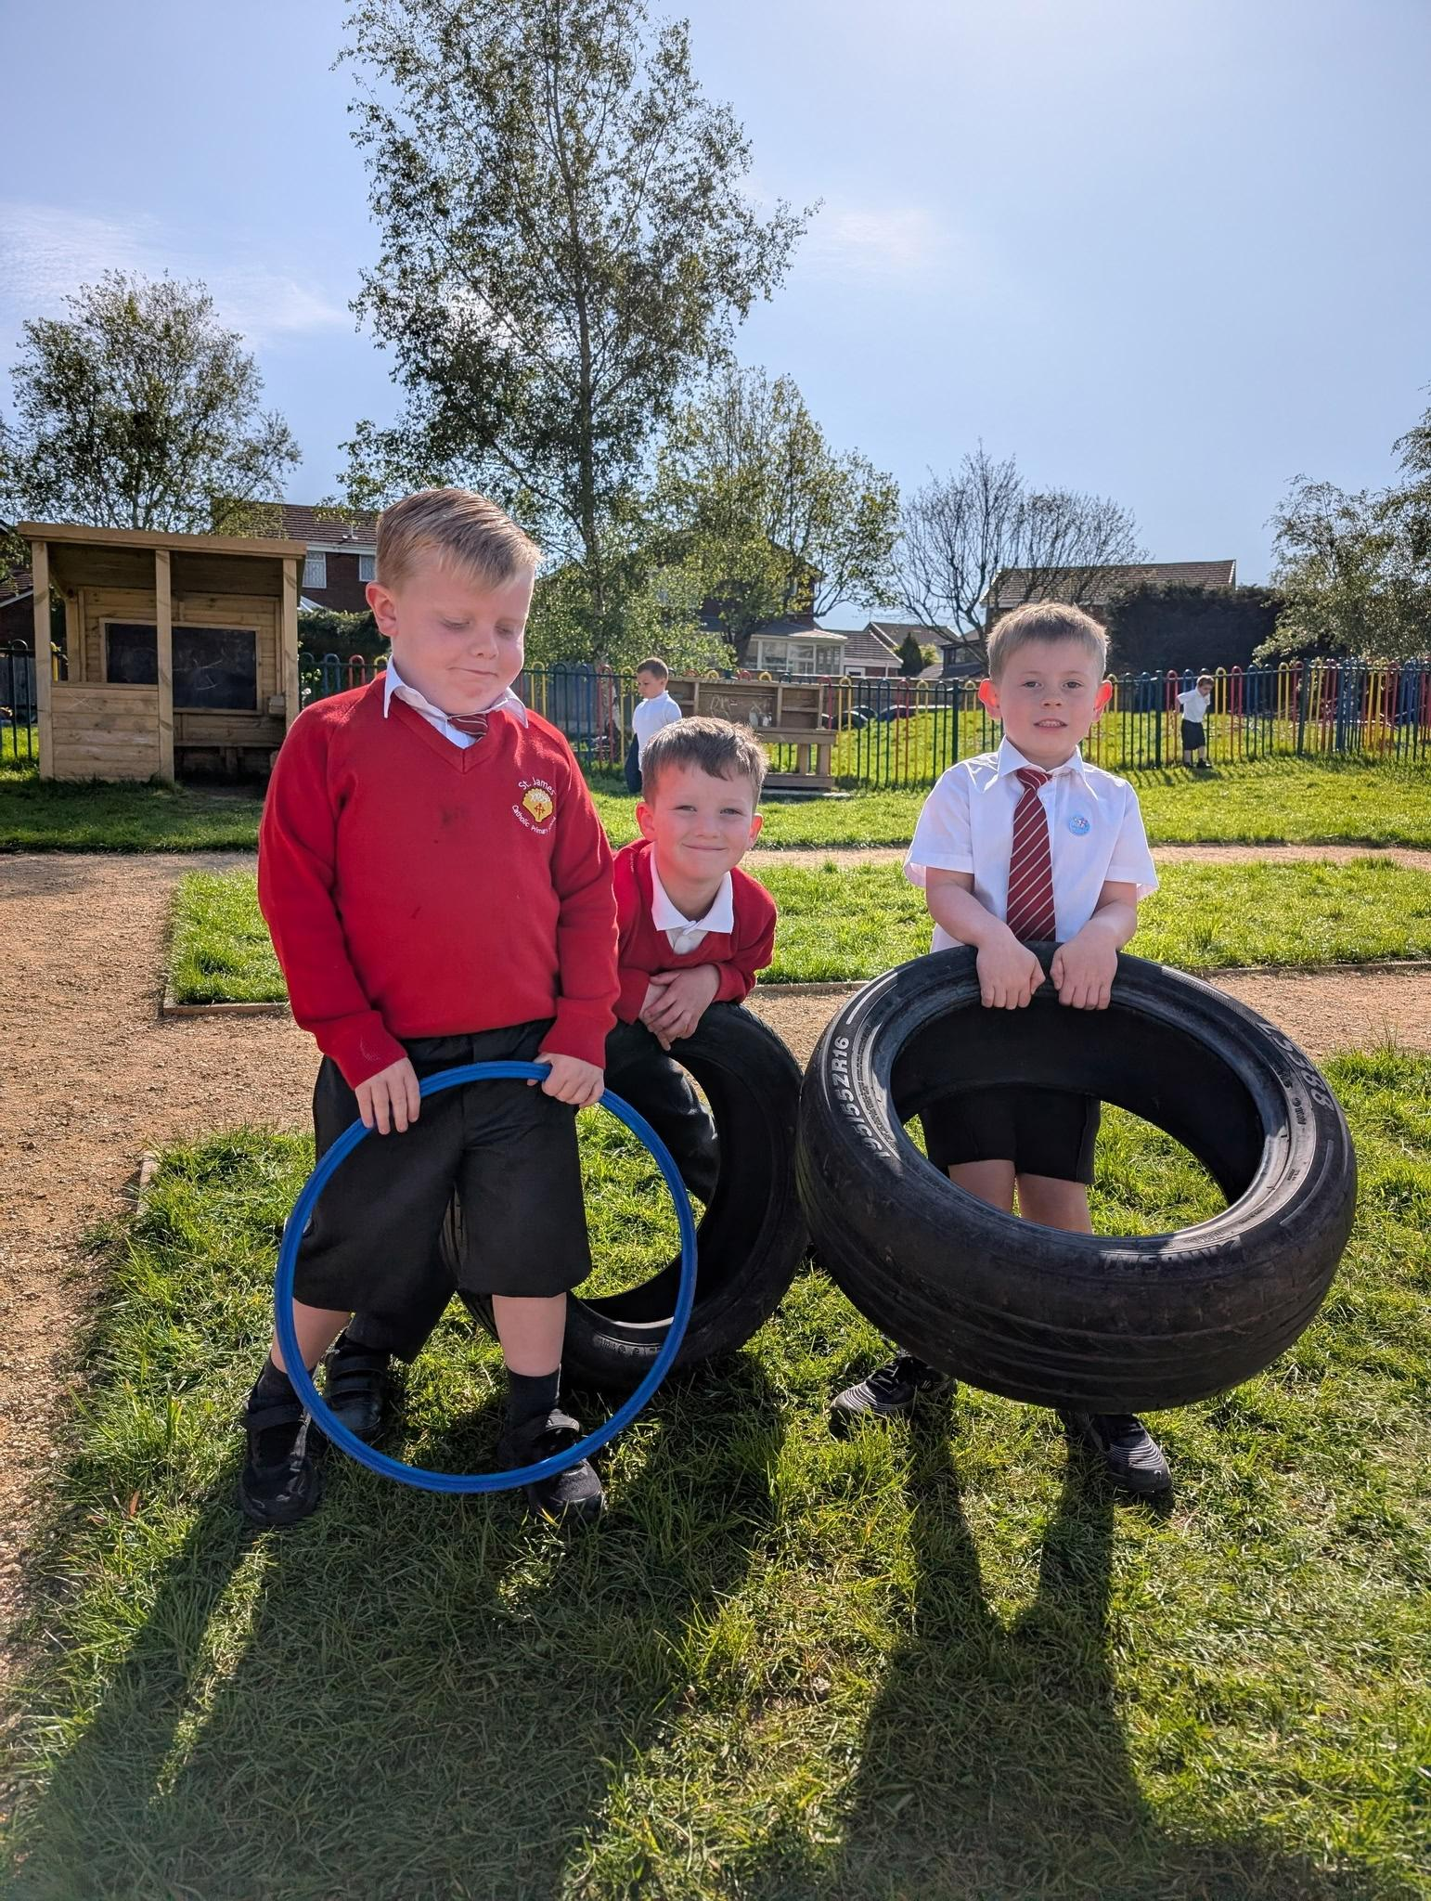
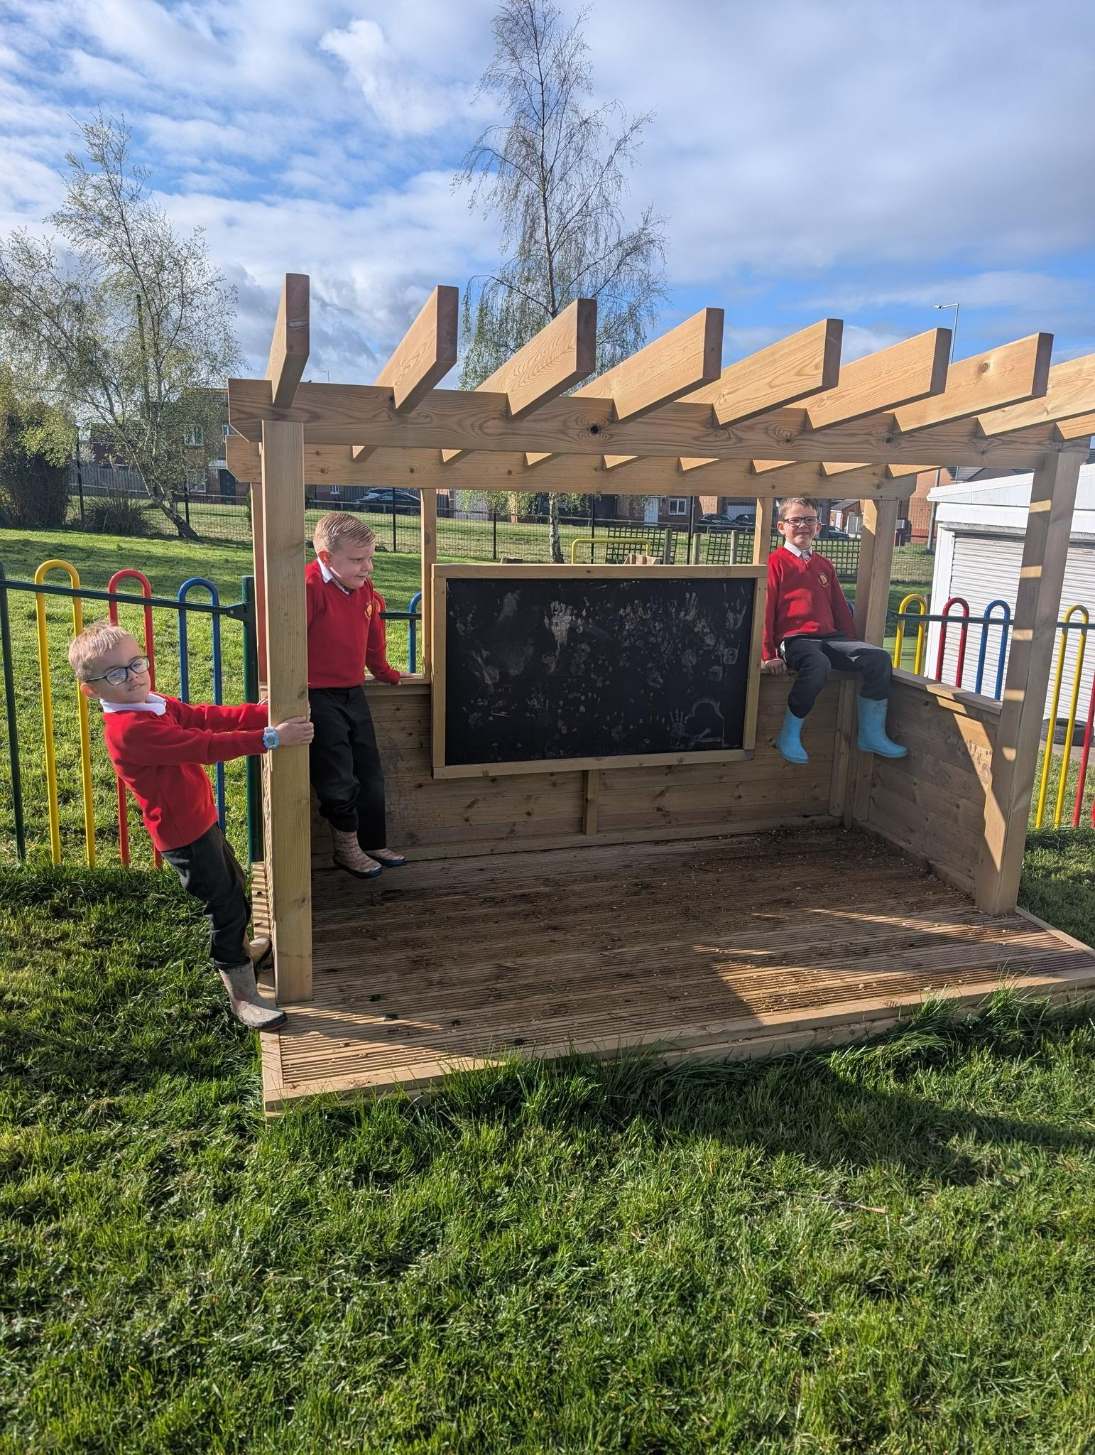
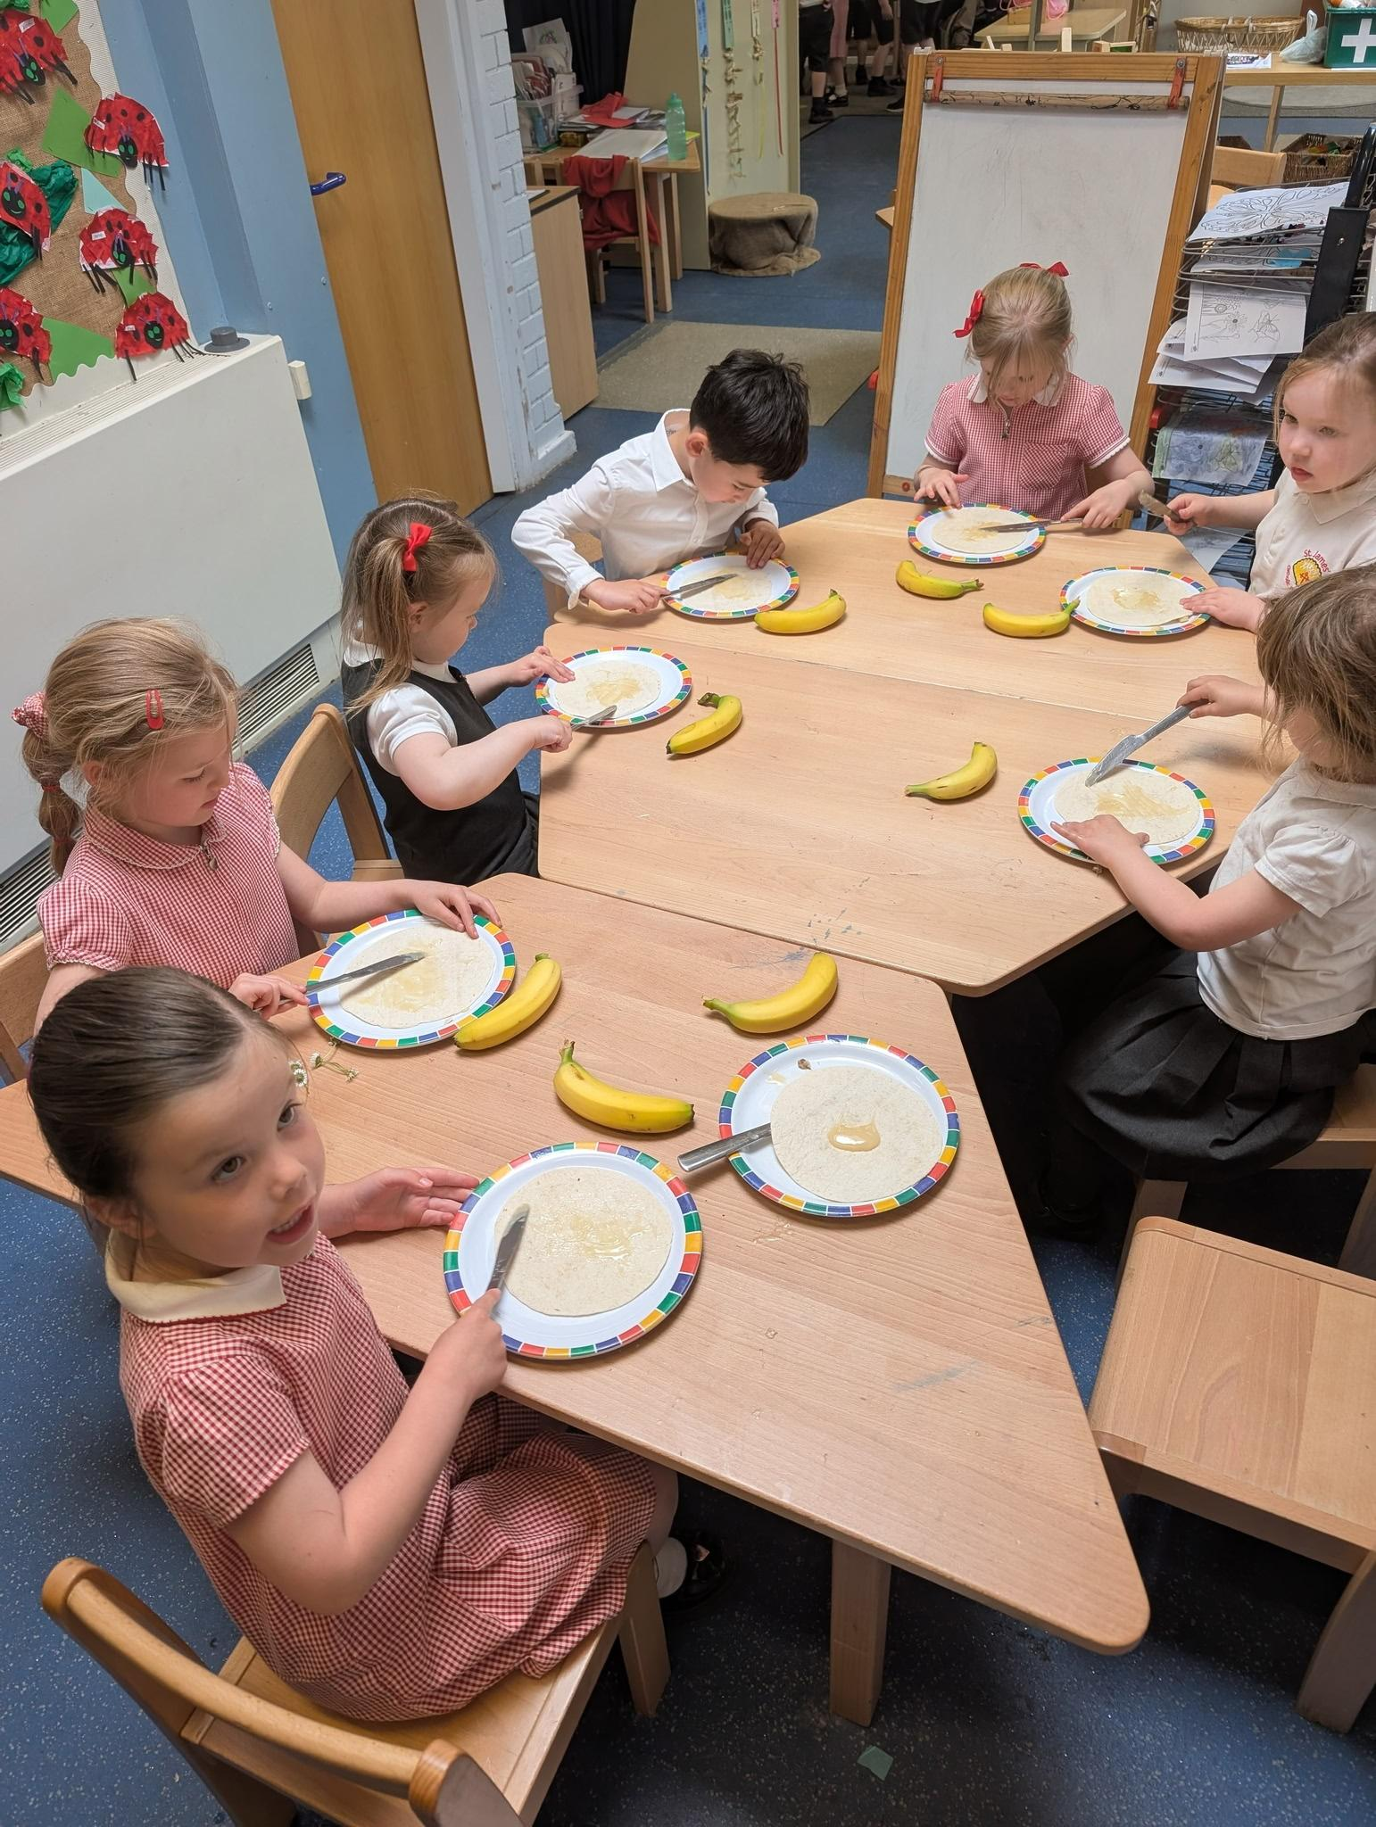

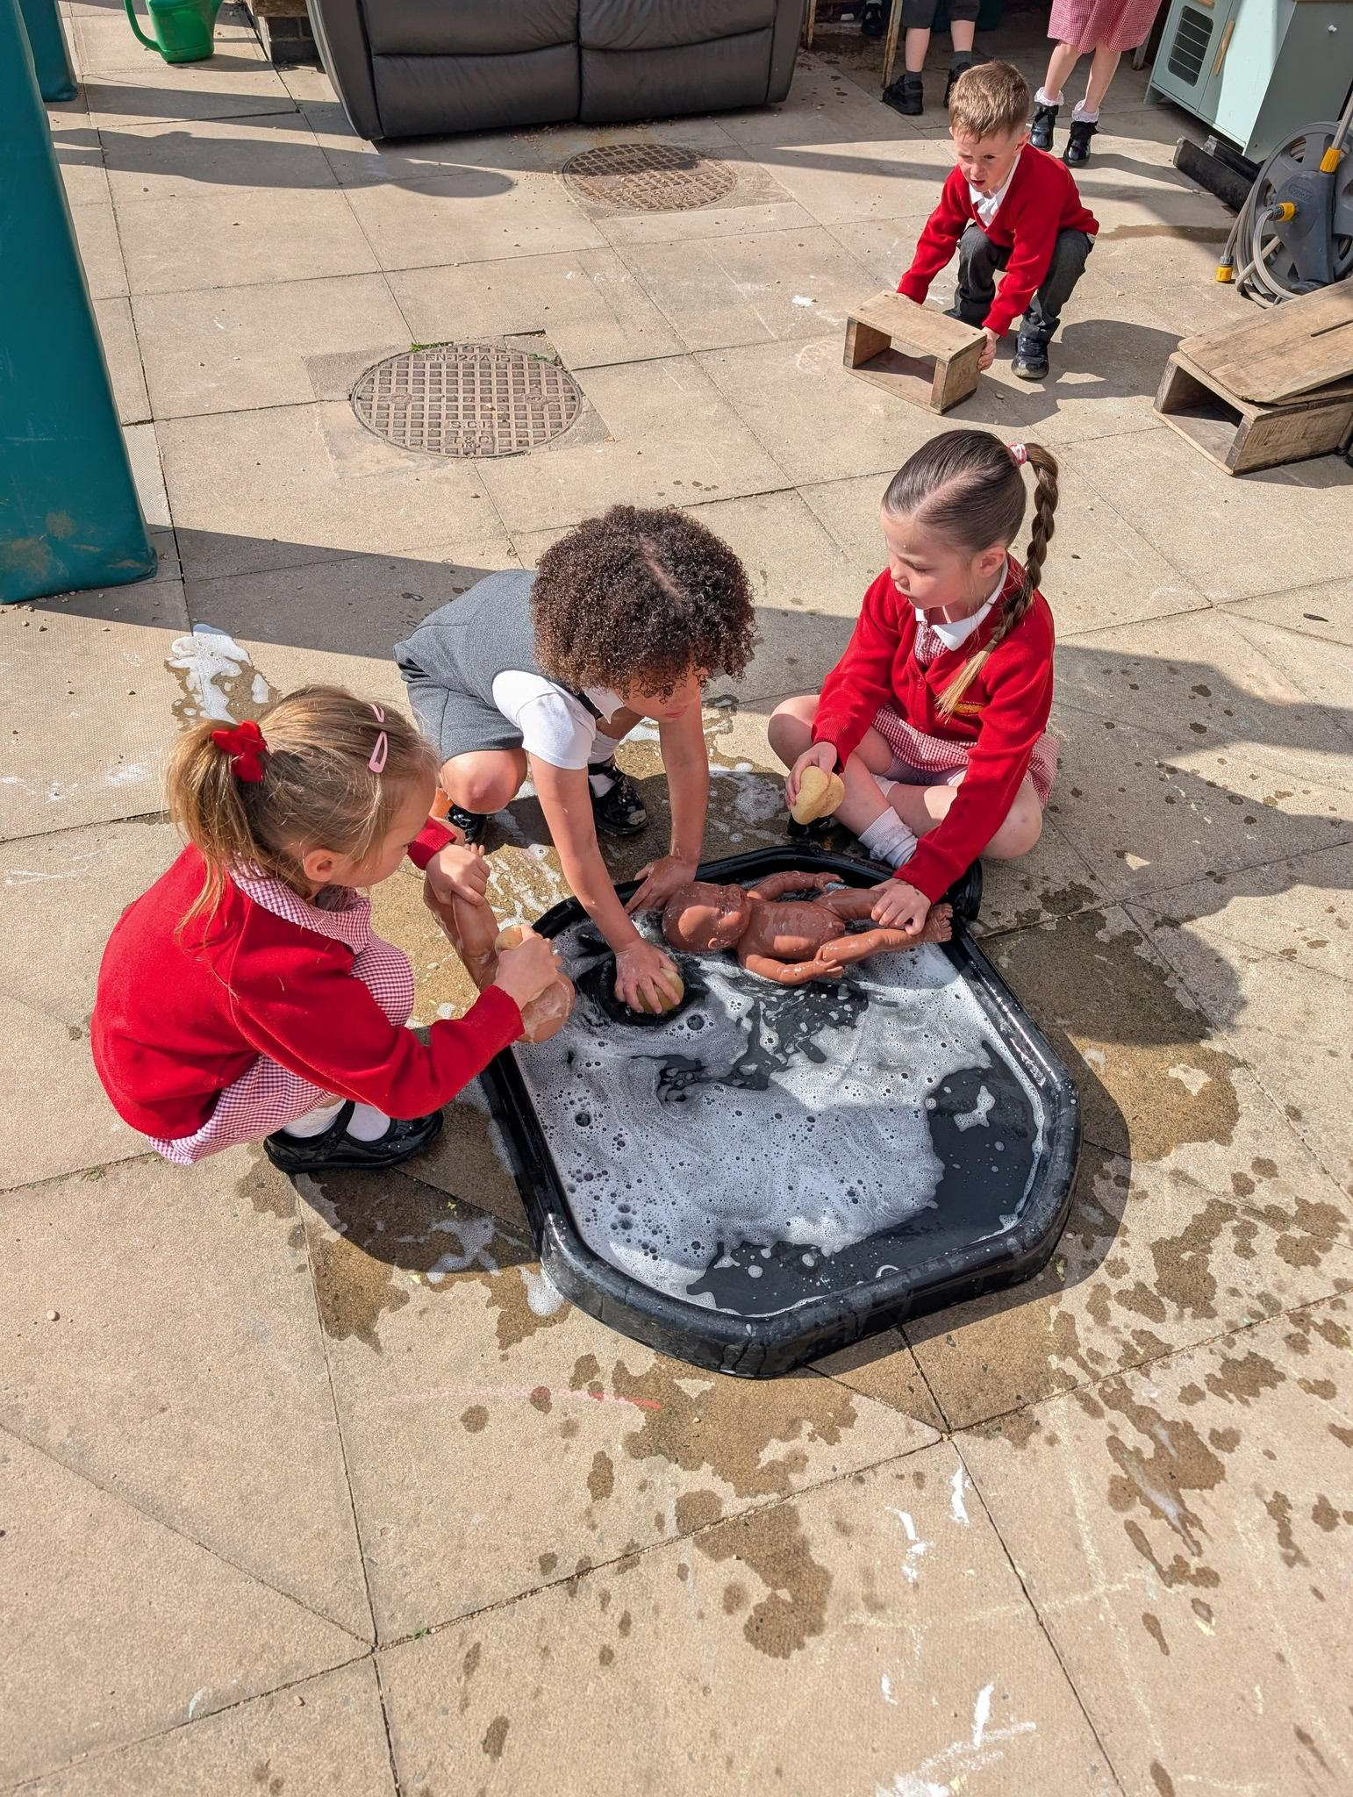
Reception September 2026

Slide 2
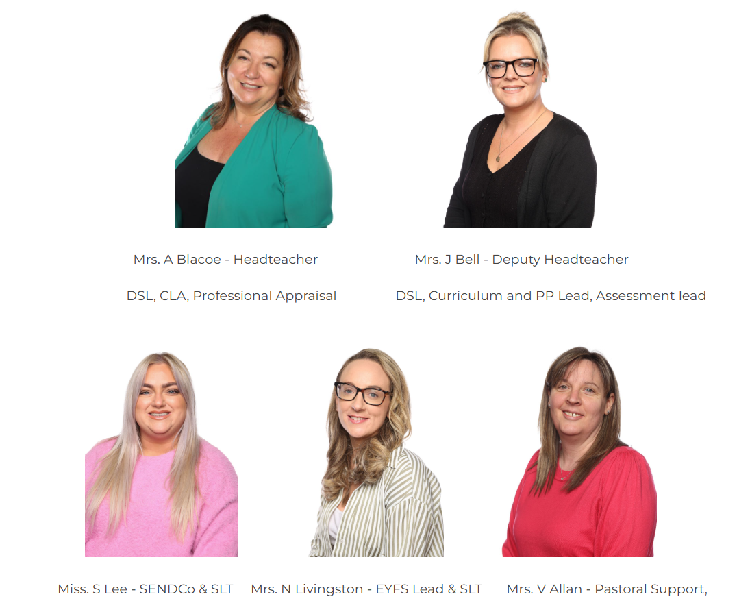
Key staff

Slide 3
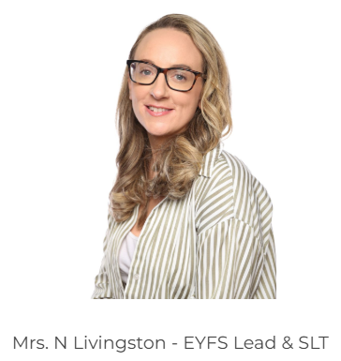
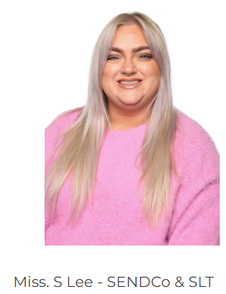
Who will be teaching Reception?
Monday - Wednesday
Wednesday - Friday

Slide 4
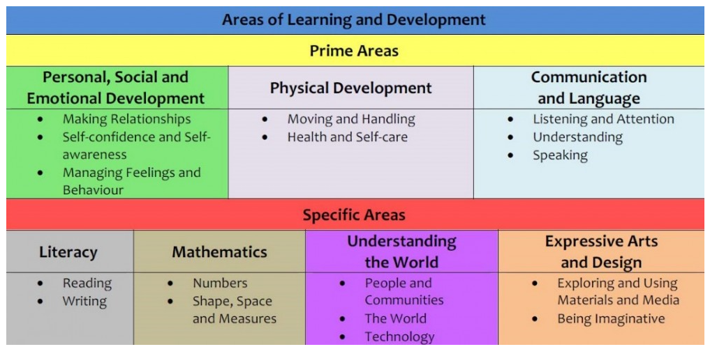
EYFS curriculum- 7 areas of learning

Slide 5


Phonics- Time for Phonics
Children are taught phonics on a daily basis, we learn a new sound each day.
They are given the opportunity to practise the sounds and write the sounds.
They are taught to read the sounds in words and sentences.
Taught in Phases- starting with Phase 2 in Reception.

Slide 6
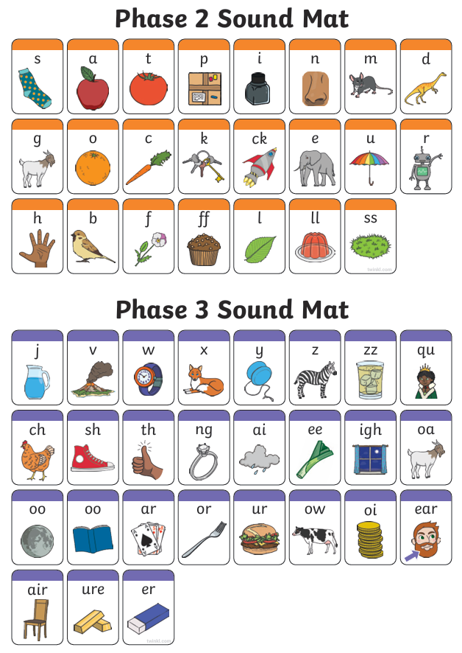

Slide 7

When are reading books changed?
Reading books are changed on a Monday and Thursday.
Books will be phonetically decodable, as your child starts to learn phonics, you will be given materials and information to support you at home.
Teach children how to look after books and handle them properly.

Slide 8
Monitoring progress
Each of the 7 areas of learning have their own set of Early Learning Goals which determine what children are expected to achieve by the end of Reception
We use Development Matters to identify the developing knowledge, skills and understanding and attitudes that children will need if they are to achieve the early learning goals by the end of Reception
Baseline assessment in first term

Slide 9
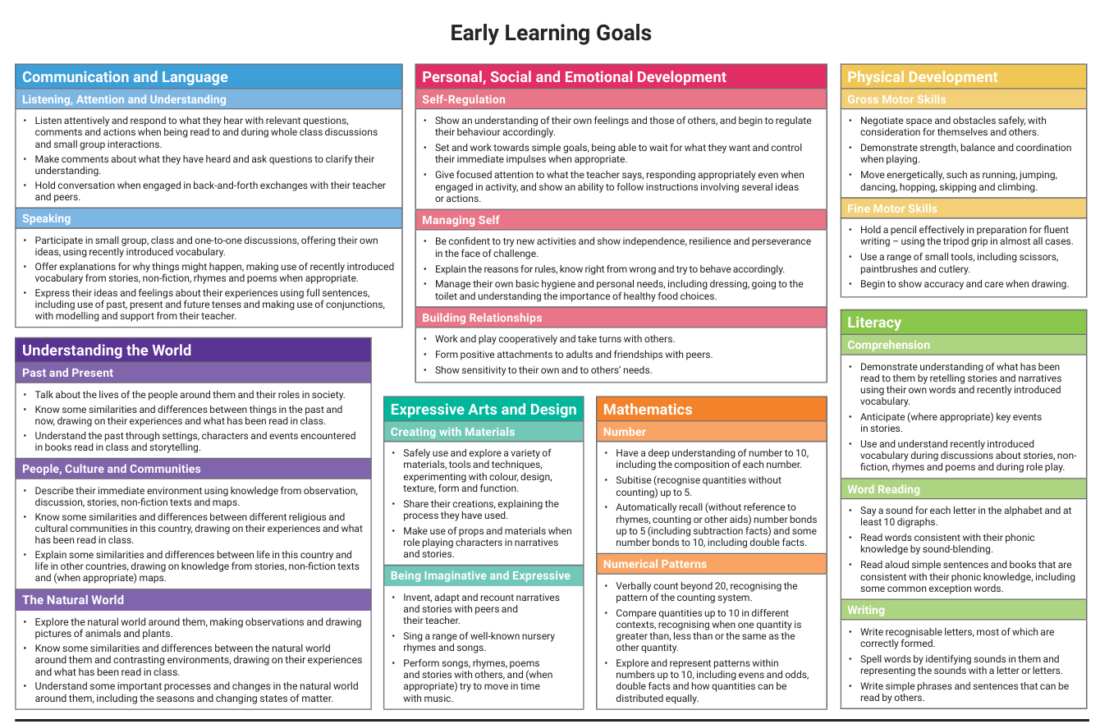

Slide 10
How is progress communicated?
A settling in call will be arranged in the first few weeks of term
A parents evening will be held in the Autumn and Spring term
A written report will be sent home in the Summer term

Slide 11
Induction into School/Starting School
We will hold a transition day on Friday 10th July where children will be invited into Reception for the day.
Visits to other nurseries and our nursery
Children start school on Wednesday 2nd September- full school days (unless stated otherwise)

Slide 12
The first few days…
All clothing, shoes and wellington boots must be labelled
Water bottle- also labelled
School book bag- this must be brought every day once books are handed out
No rucksacks or large bags please
Lunch boxes (if your child is bringing their own lunch)
Children are given toast or fruit as morning snack (provided by school, toast requires a termly payment) we also have an afternoon snack of fruit (provided by school) however, children can bring their own labelled healthy snack for afternoon snack if they prefer.
Free school meals- all children are eligible for Free school meals up to Year 2.

Slide 13
Being school ready
It would help if your child can…
Recognise their name
Count to 10 and recognise some numbers
Use the toilet independently and wash their hands
Handle a pencil
Share toys and equipment
Try to cut up their own food using cutlery
Know their colours and some basic shapes
Be able to put their coat on and attempt to do the zip themselves
Sing some nursery rhymes
Be able to tidy up

Slide 14
How you can help at home
Speaking and listening skills
Taking turns to talk
Listening for short periods
Holding a conversation- talking back and forth
Behaviour boundaries/following rules
Follow consistent routines at home- particularly at bedtime (limit screen time before bed)
Manners (please/thank you)
Tidy up when they finish an activity

Slide 15
How you can help at home
Number skills
Counting daily/saying number names out loud
Look for numbers in the environment
Counting sorting toys
Board games that involve dice
Mark making
Fine motor skills (colouring/threading/playdough/using scissors)
Writing their name
Gross motor skills (Climbing equipment/throwing/large drawing- water and paint brushes on concrete)

Slide 16
How we learn
Play based learning
Whole class learning
Small group learning
Individual work

Slide 17
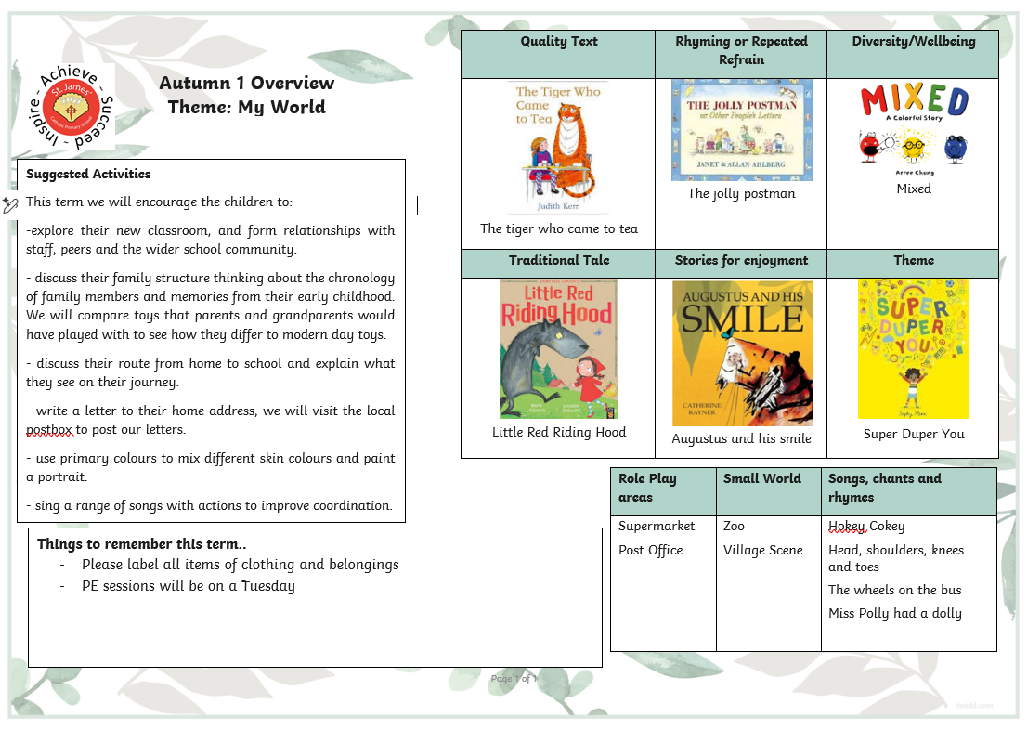
.

Slide 18

Communication
Class Dojo is the main way that we will communicate with you about everyday goings on in the class. We will also use this as a way to notify you about upcoming events and any changes in information.
Website
School Facebook page
The Parent Pay app is used to pay for anything in school and Mrs Cowell in the school office can help with this.

Slide 19

Pick up/Drop off/ Passwords
Parents will be able to pick up children at the main classroom door.
Drop off each morning will be 8:40am. Children will need to be in class ready to be registered at 8:50am.
Collection time will be 3:20pm
If an alternative adult will be collecting your child, you will need to complete the password sheet for security purposes.

Slide 20
What should I do if my child needs to miss school for any reason?
We politely request that you do not schedule holidays during the school term, however, we understand that absence of leave may sometimes be needed. If your child will need to miss school for any reason, please complete an ‘Absence of Leave form’, which is available at the main office. You leave request will then be passed to Mrs Blacoe, however, it is unlikely to be approved unless it is exceptional circumstances.
If your child is unwell, you need to contact the main office on, each day of absence, to advise us that they will not be attending that day.
If your child needs to attend a medical appointment, you will need to show the main office proof of your appointment.

Slide 21
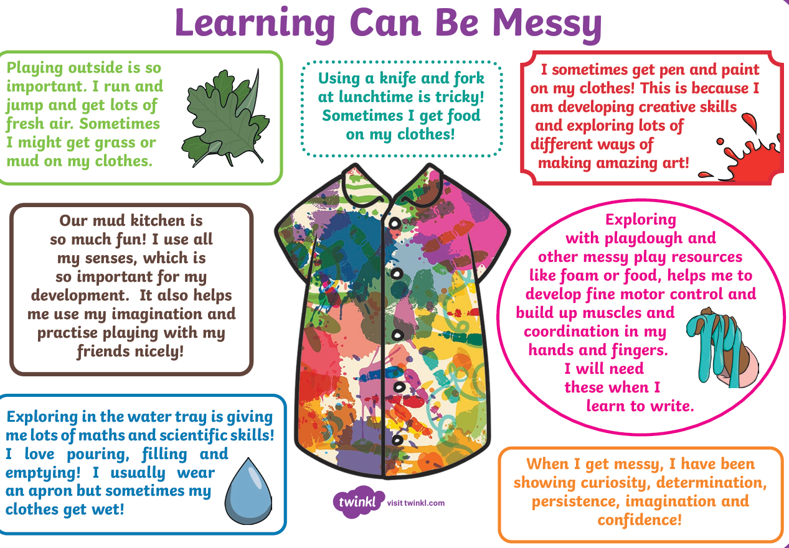
Uniform/Clothing
Please ensure that your child’s name is in all items of clothing (including shoes)
Please send in spare underwear and socks in their book bag.
Lots of our exciting and interesting activities can be messy, so children may come home a bit dirty- this is all a part of the learning process
Uniform can be ordered from Premier School wear in Ormskirk

Slide 22
Things to know…
PE Tuesday- children need to come to school in their PE kits. We will let you know when they need to start wearing outdoor kits.
Buddy time - we will be mixing with the Year 6 children and the children will each be assigned a buddy. We will have time to play together in our outdoor area. We find this builds secure bonds and relationships with the older children within the school.
Show and Tell - This will take place according to a timetable each day. We will issue a timetable, so you know which day your child needs to bring something in to show.
If you have any concerns or questions- please let us know, we are here to help.

Slide 23




The Nothing Poem
When children come home
At the end of the day,
There’s a question they’re asked
As they’re rushing to play..
“What did you do in school today?”
“Nothing! I did nothing today!”
But nothing can mean that I played with blocks,
Tied my own shoes or found beautiful rocks,
Maybe the butterflies hatched today,
Or maybe I found a new friend to play.
Maybe today was the very first time,
My scissors followed a very straight line,
Perhaps I learned a new song and danced to the beat,
Or wrote my own name and my writing was neat.
When you’re in school, and your heart has wings,
“Nothing!” can mean such wonderful things.
Author unknown

