Slide 1
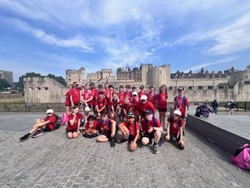
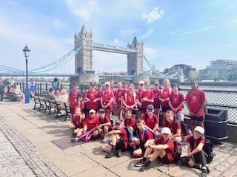
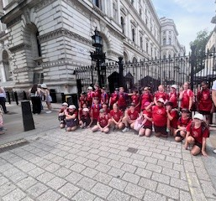
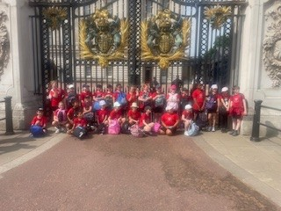
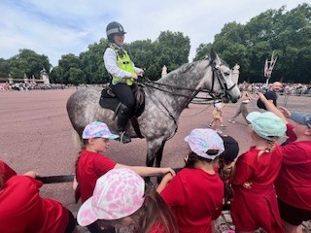
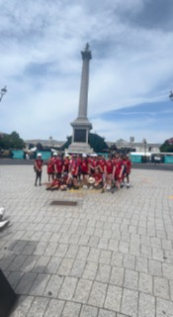
London Trip
June 2027

Slide 2
Propose Itinerary
Day 1
Early Train from Wigan North West to London Euston
Bag drop at Royal National Hotel
River Tour on the Thames
Monuments tour
London Eye
Evening Meal out
Evening Theatre Performance
Overnight stay at Royal National
Day 2
Visit London Dungeons
Self guided tour of Convent Garden area – including shopping
Evening Meal at Hard Rock Café
Train Journey back – expected return (late)

Slide 3
Meals
Day 1 – Packed lunch from home for picnic in Hyde Park
Evening Meal at Pizza Hut/ Bella Italia
Day 2 – Hotel Breakfast
Self bought lunch (Group decision)
Evening Meal at Hard Rock Café (Two courses plus drink)
All included in price – Minus £28 for day two lunch and ice creams/ drinks throughout ☺

Slide 4
Costs
£399 which include a £5 reduction for customer loyalty
If £100 pound deposit paid by the end of April, this leave £299 by May 2027
Monthly breakdown - £100 by April 30th
14 Monthly Payments of £22 which will include transport trip costs and to cover lunch and ice-creams/ drinks.

